Slide 1
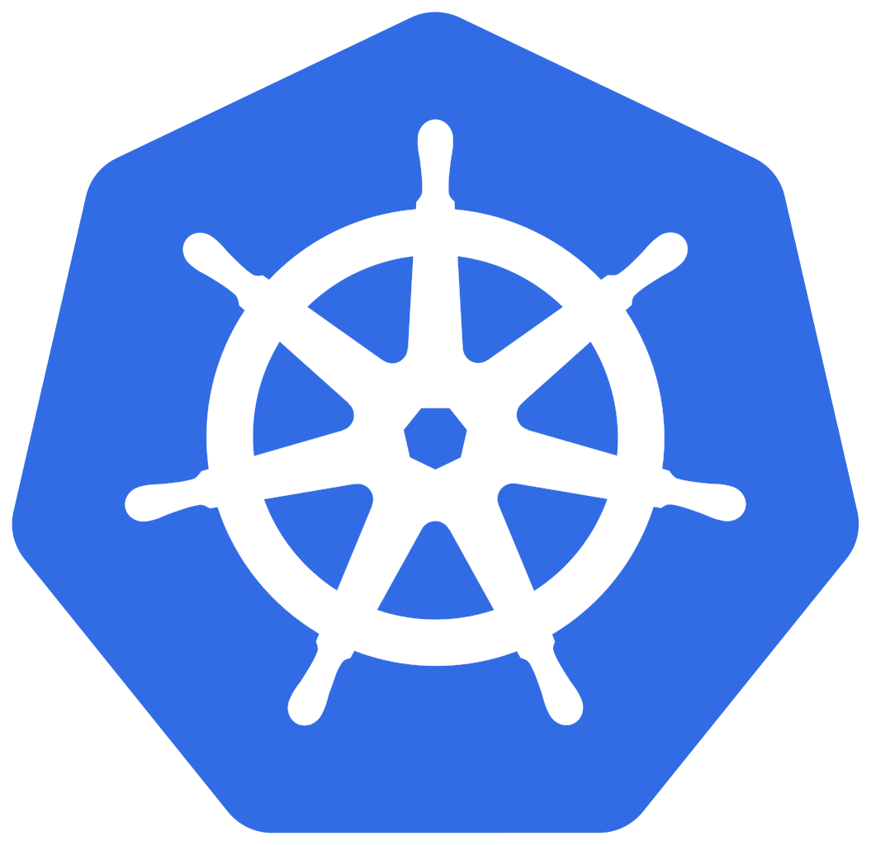
Docker and Kubernetes Dojo
Barry Tarlton
https://github.com/javaplus/DockerDojo
https://github.com/javaplus/KubernetesDojo
Please Verify Your installations by following the “Testing your Installation”
at the link above.

Slide 2

Rough Agenda
What is Docker?
Working with Docker Containers
Create custom Docker Images
Why Kubernetes?
Running containers in Kubernetes
Declarative Configuration with Kubernetes
Working With Environment Variables
Services, Ingress, Readiness, etc...

Slide 3
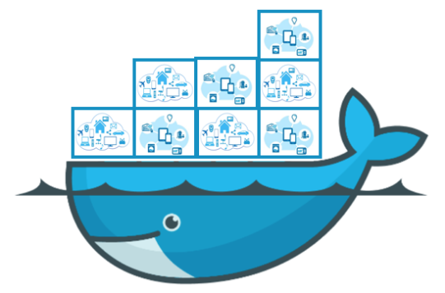
Better Way to Deploy Code Using Containers!

Slide 4
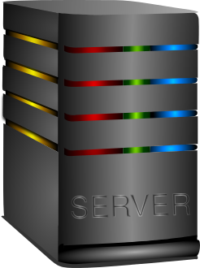

Pre-Container Days
Server
Operating System

Slide 5

Pre-Container Days
Server
Operating System

Slide 6
Pre-Container Days
Server
Operating System

Slide 7

Pre-Container Days
Server
Operating System
Application Code

Slide 8
Pre-Container Days
Server
Operating System
Application Code

Slide 9
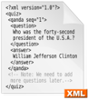
Pre-Container Days
Server
Operating System
Application Code
Config Files

Slide 10
Pre-Container Days
Server
Operating System
Application Code
Config Files

Slide 11
Pre-Container Days
Server
Operating System
OS
Configs
Application Code
Config Files

Slide 12
Pre-Container Days
Server
Operating System
OS
Configs
Application Code
Config Files

Slide 13
Pre-Container Days
Development
Operating System
OS
Configs
Application Code
Config Files

Slide 14

Pre-Container Days
Development
Operating System
OS
Configs
Application Code
Config Files

Slide 15
Pre-Container Days
Development
Test
Operating System
Operating System
OS
Configs
OS
Configs
Application Code
Application Code
Config Files
Config Files

Slide 16

Pre-Container Days
Development
Test
Operating System
Operating System
OS
Configs
OS
Configs
Application Code
Application Code
Config Files
Config Files

Slide 17
Pre-Container Days
Development
Test
Production
Operating System
Operating System
Operating System
OS
Configs
OS
Configs
OS
Configs
Application Code
Application Code
Application Code
Config Files
Config Files
Config Files

Slide 18

Pre-Container Days
Development
Test
Production
Operating System
Operating System
Operating System
OS
Configs
OS
Configs
OS
Configs
Application Code
Application Code
Application Code
Config Files
Config Files
Config Files

Slide 19
Containers
Server
Operating System
OS
Configs
Application Code
Config Files

Slide 20
Containers
Operating System
OS
Configs
Application Code
Config Files

Slide 21
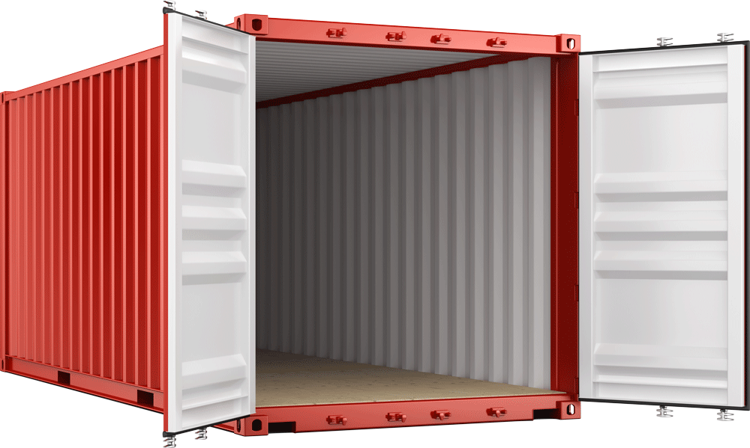
Containers
Operating System
OS
Configs
Application Code
Config Files

Slide 22
Containers
Operating System
OS
Configs
Application Code
Config Files

Slide 23
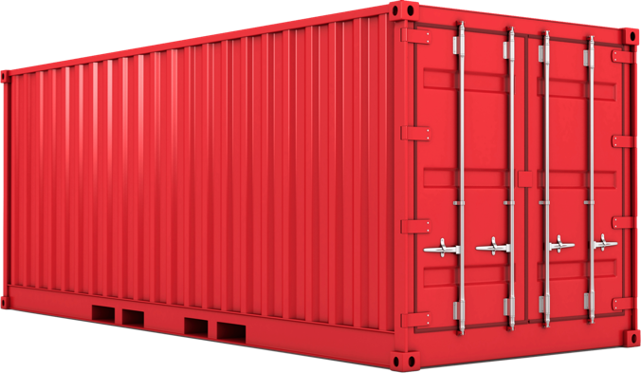
Containers
My App
Version 1

Slide 24

Containers
My App
Version 1
Docker
Image Hub
Docker
Runtime

Slide 25
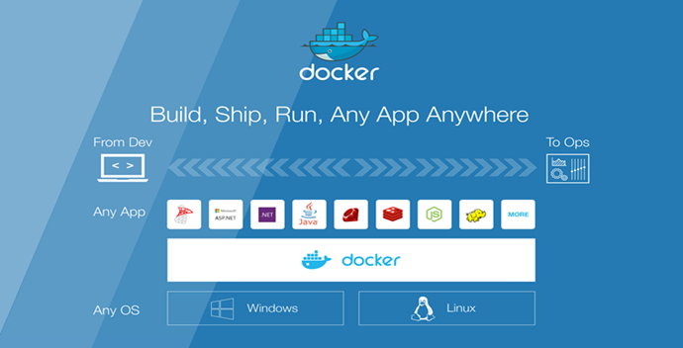

Slide 26
Running With Containers
Production
Test
Docker
My App
Version 1
Development
Docker
My App
Version 1
Docker
My App
Version 1
My App
Version 1
My App
Version 1
My App
Version 1

Slide 27
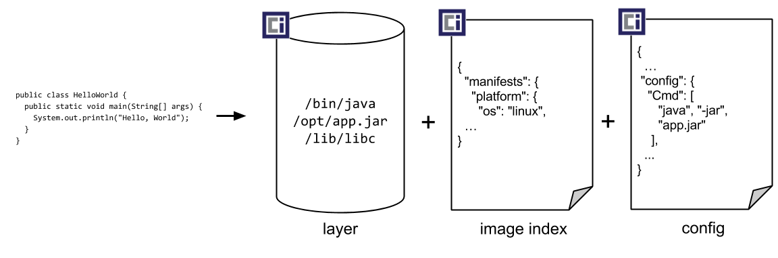
Open Container Initiative (https://opencontainers.org/)
Purpose of creating open industry standards around container formats and runtimes.
Image Format Specification - how to specify the manifest, filesystem layers, and configuration of an image
Image Distribution Specification - how to distribute images
Container Runtime Specification - how to execute a container on a specific OS

Slide 28

Docker Architecture
Daemon
REST API
Client

Slide 29

NOTE ON LABS
They are NOT a race!
Take your time!
Understand what you are doing!
Ask questions!
That’s why we are here!
GLHF! (Good Luck Have Fun!)

Slide 30

Time for Our FIRST LAB
Do Lab1
“Intro to Docker and Containers”
All links to the labs can be found:
https://github.com/javaplus/DockerDojo
Scroll down into the readme to the “~~Content:~~” section

Slide 31
Lab 1 Debrief
Q: Where did the hello-world and nginx image definitions come from?
A: hub.docker.com (technically: registry-1.docker.io)
Official images have no prefix
Your images would be prefixed with your username or org
<registry host name>/<org or user>/<sourceImage>:<tag>

Slide 32

Volume Mounts
Docker Runtime
My App
Version 1

Slide 33
Volume Mounts
Usage:
-v <local source folder>:<container folder>
Ex:
docker run –v c:\temp\html:/usr/share/nginx/html nginx
“c:\temp\html” is a local folder that the internal container folder “/usr/share/nginx/html” will be mounted to.

Slide 34

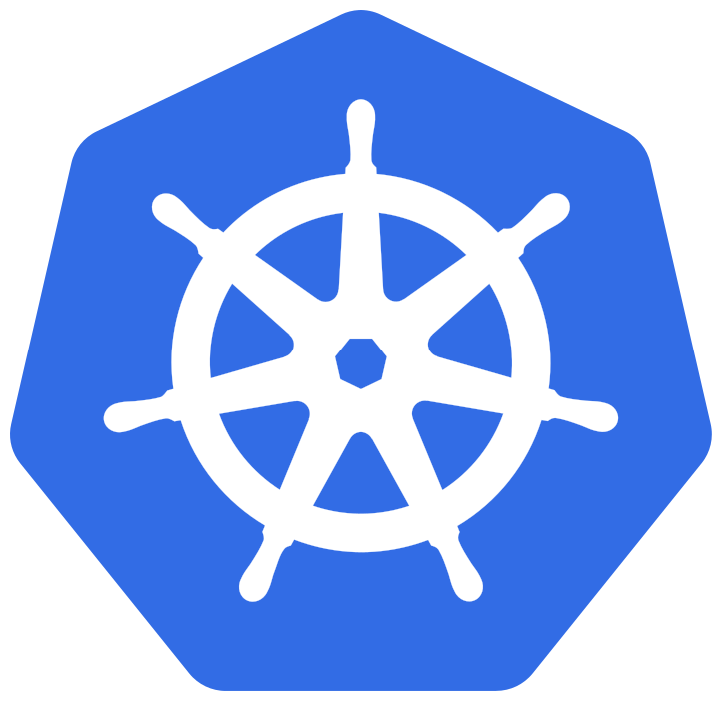
Labs

Slide 35
Why Kubernetes?

Slide 36
Take what runs well locally on a single machine with "docker run …" and do the same reliably and securely across a distributed cluster of potentially hundreds of machines

Slide 37
Container Scheduling and Orchestration
Kubernetes Master
Worker Node 1
Worker Node 2
Worker Node 3
Determines where containers run
Container Runtime
Kubernetes Cluster

Slide 38
Container Scheduling and Orchestration
Kubernetes Master
Worker Node 1
Worker Node 2
Worker Node 3

Slide 39
Labs

Slide 40
POD
Smallest deployable unit of computing that you can create and manage in Kubernetes.
Pod
Containers
CPU / Memory
Env Vars
Volumes
Health checks

Slide 41
Labs

Slide 42
Kubernetes Deployments

Slide 43
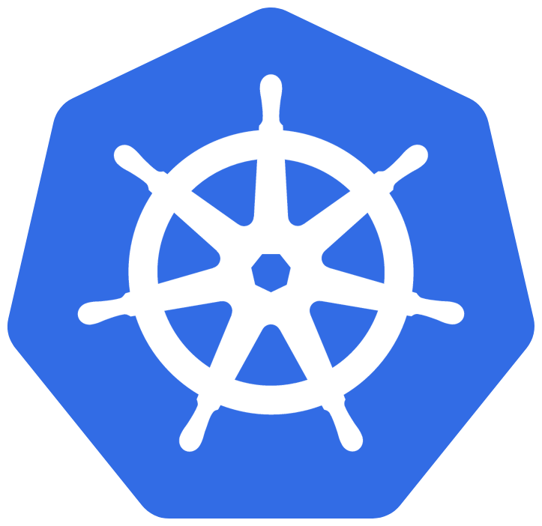
Kubernetes Deployments
Take what runs well locally on a single machine with "docker run …" and do the same reliably and securely across a distributed cluster of potentially hundreds of machines
docker run \ --name my-app \ --env DATABASE=jdbc:postgresql://localhost/test \ --volume $(pwd)/conf:/usr/local/etc my-app:1.0.0
Deployment
Pod
Pod
Containers
CPU / Memory
Env Vars
Volumes
Health checks
Pod

Slide 44
Kubectl syntax
kubectl <verb> <resource-noun> <resource-name>
> kubectl get deployments cn-demo -v 6
I1227 12:10:48.658948 3925 round_trippers.go:443] GET https://kubernetes.docker.internal:6443/apis/extensions/v1beta1/namespaces/default/deployments/cn-demo 200 OK in 15 milliseconds
NAME READY UP-TO-DATE AVAILABLE AGE cn-demo 1/1 1 1 2m17s
Other varieties (kubectl help to see all commands)
> kubectl get … > kubectl edit … > kubectl delete …

Slide 45

Let’s DO it Together
“Kubernetes Infrastructure as Code”

Slide 46
Kubernetes Deployment Manifest
GET https://kubernetes.docker.internal:6443/apis/extensions/v1beta1/namespaces/default/deployments/cn-demo
> kubectl get deployments cn-demo -o yaml apiVersion: extensions/v1beta1 kind: Deployment metadata: annotations: deployment.kubernetes.io/revision: "1" labels: run: cn-demo name: cn-demo namespace: default spec: … … …
> kubectl get deployments cn-demo -o json { "apiVersion": "extensions/v1beta1", "kind": "Deployment", "metadata": { "annotations": { "deployment.kubernetes.io/revision": "1" }, "labels": { "run": "cn-demo" }, "name": "cn-demo", "namespace": "default", }, "spec": … }

Slide 47
Kubernetes Networking
Kubernetes Service Types
ClusterIP
NodePort
LoadBalancer
Why the need for “kubectl port-forward”?
Kubernetes
Cluster Network
Node 1
eth0
Node 2
eth0
Pod
Pod
Pod
Pod
Pod
Pod

Slide 48



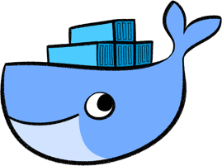
Deploying to the Cloud
Docker Registry
(Docker Hub)
AWS EKS
AWS EC2
images
images
Node 1
Node 2
Node 1
Node 2
Pod
Pod
Pod
Pod
Deploy
Deploy
Pod
Pod
Pod
Pod
Deploy.yml
> kubectl apply –f
DockerDesktop

Slide 49

Lab Time

Slide 50
Kubernetes Services and Ingress

Slide 51
The big picture ...
“Ingress” maps HTTP requests to Services
“Services” load balance network traffic across Pods
“Pods” define how to run your containers
“Deployments” make sure your desired number of “Pods” are always running
Configuration is stored in ConfigMaps and Secrets, and made available to the container
Kubernetes Cluster
Deployment
SpringBoot
Pod
HTTPD
https://abc.xyz
Ingress
Service
Pod
Pod
NETWORK

Slide 52
The big picture … Namespaces
Resource Quotas
CPU / Memory
Object counts
Resource Isolation
Naming
Scheduling
Security
RBAC
Network Policy
Kubernetes
Namespace A
Namespace B
ConfigMaps / Secrets
ConfigMaps / Secrets
Deployment
Deployment
Pod
Pod
Service
Pod
Service
Pod
Pod
Pod

Slide 53

Lab 8
“Kubernetes Ingress”

Slide 54
Service to Pod selector
apiVersion: v1
kind: Service
metadata:
labels:
run: nginx
name: nginx
spec:
ports:
- port: 80
protocol: TCP
targetPort: 80
selector:
run: nginx
type: ClusterIP
apiVersion: v1
kind: Pod
metadata:
creationTimestamp: null
labels:
run: nginx
name: nginx
spec:
containers:
- image: nginx
name: nginx
resources: {}
dnsPolicy: ClusterFirst
restartPolicy: Never

Slide 55
Service to Pod selector
apiVersion: v1
kind: Pod
metadata:
creationTimestamp: null
labels:
run: nginx
version: 1.0
name: nginx
spec:
containers:
- image: nginx:1.16.0
...
apiVersion: v1
kind: Service
metadata:
labels:
run: nginx
name: nginx
spec:
...
...
selector:
run: nginx
version: 1.0
type: ClusterIP
apiVersion: v1
kind: Pod
metadata:
creationTimestamp: null
labels:
run: nginx
version: 2.0
name: nginx
spec:
containers:
- image: nginx:1.17.2
...

Slide 56
Service to Pod selector
apiVersion: v1
kind: Pod
metadata:
creationTimestamp: null
labels:
run: nginx
version: 1.0
name: nginx
spec:
containers:
- image: nginx:1.16.0
...
apiVersion: v1
kind: Service
metadata:
labels:
run: nginx
name: nginx
spec:
...
...
selector:
run: nginx
version: 2.0
type: ClusterIP
apiVersion: v1
kind: Pod
metadata:
creationTimestamp: null
labels:
run: nginx
version: 2.0
name: nginx
spec:
containers:
- image: nginx:1.17.2
...

Slide 57
Ingress to Service selector
apiVersion: extensions/v1beta1
kind: Ingress
metadata:
name: blue-green
spec:
rules:
- host: blue-green.127.0.0.1.xip.io
http:
paths:
- path: /
backend:
serviceName: nginx
servicePort: 80
apiVersion: v1
kind: Service
metadata:
labels:
run: nginx
name: nginx
spec:
ports:
- port: 80
protocol: TCP
targetPort: 80
selector:
run: nginx
type: ClusterIP

Slide 58

Labs

Slide 59
Where to go next
Application Configuration
Environment Variables
ConfigMaps
Secrets
Other resources
Docker Desktop
Simple to provision local Kubernetes environment
https://github.com/frayer/kubernetes-patterns
https://www.katacoda.com
Udemy CKAD Course is excellent!
https://www.udemy.com/course/certified-kubernetes-application-developer/
Learn by doing

Slide 60
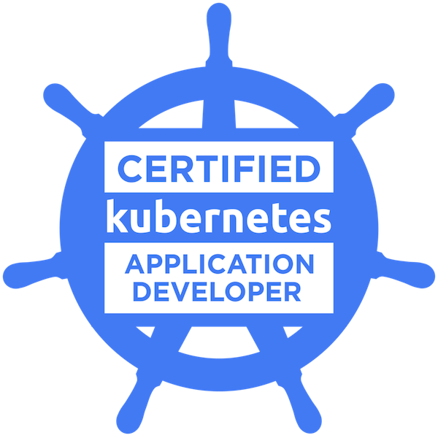
Thank you!
Barry Tarlton - btarlton@gmail.com
https://github.com/javaplus/DockerDojo
https://github.com/javaplus/KubernetesDojo

